Slide 1
Computer Vision
Final Project
Panorama Stitching
Zhe ZHANG, 1754060
Kaixin CHEN, 1753188
Yunxin SUN, 1551534
School of Software Engineering
Tongji University
Spring 2020
Group, SSE, 2020

Slide 2
Content
SIFT
Scale Space and Image Pyramids
Localizing Extrema
Generating Orientations and Descriptors
SURF
Hessian Detector
Math Behind Hessian Matrix
Construction of feature vector
Comparision between SIFT and SURF
Results
Fast Panorama Stitching on Mobile
Current Approaches
Summary
Color and Luminance Compensation
Optimal Seam Finding and Image Labeling
Image Blending
Results
Group, SSE, 2020

Slide 3
Content
SIFT
Scale Space and Image Pyramids
Localizing Extrema
Generating Orientations and Descriptors
SURF
Hessian Detector
Math Behind Hessian Matrix
Construction of feature vector
Comparision between SIFT and SURF
Results
Fast Panorama Stitching on Mobile
Current Approaches
Summary
Color and Luminance Compensation
Optimal Seam Finding and Image Labeling
Image Blending
Results
Kaixin CHEN, SSE, 2020

Slide 4
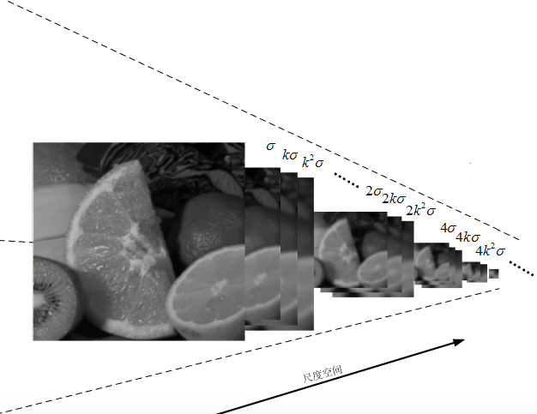
SIFT —— Scale Space & Image Pyramids
The Gaussian pyramid imitates different scales of the image --"the depth of the image"
The problem solved by the scale space of the image is how to describe the image at all scales.
Kaixin CHEN, SSE, 2020
Notes:
建立高斯金字塔的过程中，
高斯金字塔模仿的是图像的不同的尺度，也可以理解成“图像的纵深”，图像原就会模糊而趋于整体，近就会清晰而关注细节。图像的尺度空间解决的问题，是如何对图像在所有尺度下进行描述的问题。
实现方法中，高斯核是唯一的线性核，也就是说使用高斯核对图像模糊不会引入其他噪声，因此就选用了高斯核来构建图像的尺度。
Scale Space and Image Pyramids

Slide 5
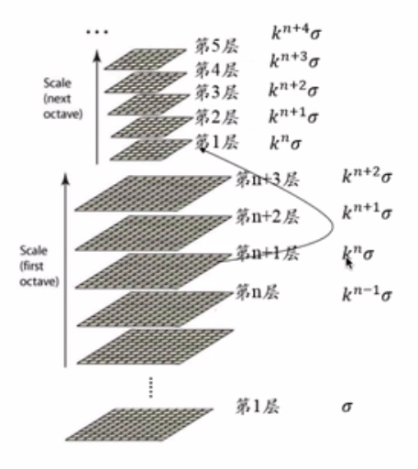
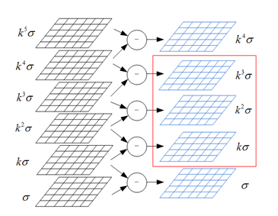
SIFT —— Scale Space & Image Pyramids
Kaixin CHEN, SSE, 2020
Notes:
建立高斯金字塔的过程，实际上也就是将原始图像不断降阶采样，得到一系列大小不一的图像的过程。
图像分组，组内分层，在同一组（子八度，octave）内，不同层图像的尺寸是一样的，后一层图像的高斯平滑因子σ是前一层图像平滑因子的k倍；
在不同组内，为了保证尺度空间的连续性， 后一组第一个图像是前一组 倒数第三个 图像的二分之一采样，图像大小是前一组的一半。

Slide 6
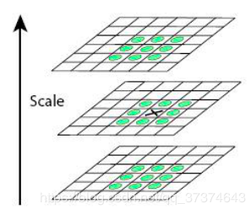
SIFT —— Localizing Extrema
Kaixin CHEN, SSE, 2020
Notes:
而极值点定位的过程，
是由DOG空间的局部极值点组成的。
从每组的第二层开始，以第二层为当前层，区一层上一层下，以中心点进行3X3X3的相邻点比较,检测其是否是图像域和尺度域的相邻点的极大值或极小值。
这里涉及到了一系列的优化措施。

Slide 7
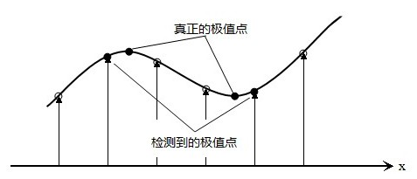
SIFT —— Localizing Extrema
Sub-pixel interpolation
True Extrema
Detected Extrema
Kaixin CHEN, SSE, 2020
Notes:
首先，因为极值点的搜索是在离散空间中进行的，检测到的极值点并不是真正意义上的极值点。
==============
极值点的搜索是在离散空间中进行的，检测到的极值点并不是真正意义上的极值点。
假设我们在尺度为𝜎σ的尺度图像𝐷(𝑥,𝑦)D(x,y)上检测到了一个局部极值点，空间位置为(𝑥,𝑦,𝜎)(x,y,σ)，由上面的分析我们知道，它只是一个离散情况下的极值点，连续情况下，极值点可能落在了(𝑥,𝑦,𝜎)(x,y,σ)的附近，设其偏离了(𝑥,𝑦,𝜎)(x,y,σ)的坐标为(Δ𝑥,Δ𝑦,Δ𝜎)(Δx,Δy,Δσ)。则对𝐷(Δ𝑥,Δ𝑦,Δ𝜎)D(Δx,Δy,Δσ)可以表示为在点(𝑥,𝑦,𝜎)(x,y,σ)处的泰勒展开：

Slide 8
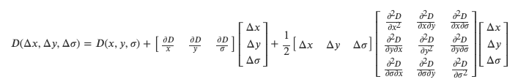
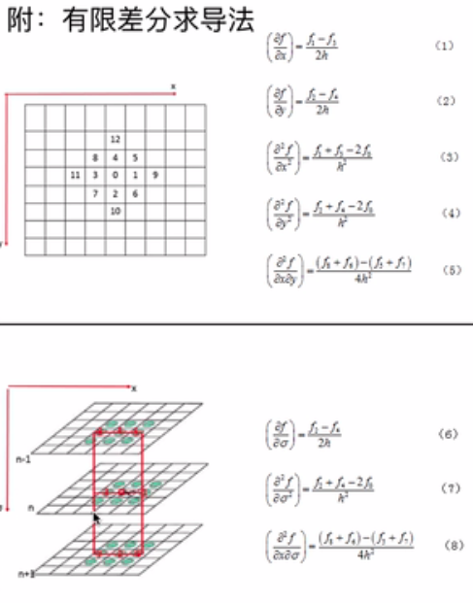
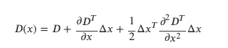
SIFT —— Localizing Extrema
Sub-pixel interpolation
Finite difference method:
Derivation, substitution, iterative process to get new expression
Kaixin CHEN, SSE, 2020
Notes:
所以会通过泰勒展开模拟曲线方程，用有限差分代替导数计算，通过多次迭代(Lowe算法里最多迭代5次)，得到最终候选点的精确位置与尺度。
============
假设我们在尺度为𝜎σ的尺度图像𝐷(𝑥,𝑦)D(x,y)上检测到了一个局部极值点，空间位置为(𝑥,𝑦,𝜎)(x,y,σ)，由上面的分析我们知道，它只是一个离散情况下的极值点，连续情况下，极值点可能落在了(𝑥,𝑦,𝜎)(x,y,σ)的附近，设其偏离了(𝑥,𝑦,𝜎)(x,y,σ)的坐标为(Δ𝑥,Δ𝑦,Δ𝜎)(Δx,Δy,Δσ)。则对𝐷(Δ𝑥,Δ𝑦,Δ𝜎)D(Δx,Δy,Δσ)可以表示为在点(𝑥,𝑦,𝜎)(x,y,σ)处的泰勒展开：
通过多次迭代(Lowe算法里最多迭代5次)，得到最终候选点的精确位置与尺度𝑥̂ x^，将其代入公式求得𝐷(𝑥̂ )D(x^)，求其绝对值得|𝐷(𝑥̂ )||D(x^)|。如果其绝对值低于阈值的将被删除。

Slide 9
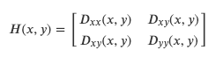
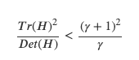
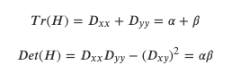
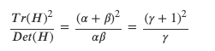
SIFT —— Localizing Extrema
Edge effect removal
A flat DoG response peak tends to have a larger main curvature across the edge and a smaller main curvature in the direction of the vertical edge.
Kaixin CHEN, SSE, 2020
Notes:
同时由于DoG对图像中的边缘有比较强的响应值，而一旦特征点落在图像的边缘上，这些点就是不稳定的点，
所以还要根据“在横跨边缘的地方有较大的主曲率，而在垂直边缘的方向有较小的主曲率”这一性质，通过计算Hessian矩阵的直迹、行列式进行计算，删除曲率不符合性质的点。
此外还有阈值二值化、舍去低对比度的极值点等操作，不多赘述。
==========
由于DoG对图像中的边缘有比较强的响应值，而一旦特征点落在图像的边缘上，这些点就是不稳定的点。一方面图像边缘上的点是很难定位的，具有定位歧义性；另一方面这样的点很容易受到噪声的干扰而变得不稳定。
而主曲率可以通过2×22×2的Hessian矩阵𝐻H求出 ？？？怎么求
令𝛼=𝜆𝑚𝑎𝑥α=λmax为最大的特征值，𝛽=𝜆𝑚𝑖𝑛β=λmin为最小的特征值
通过𝐻H矩阵直迹计算它们的和，通过𝐻H矩阵的行列式计算它们的乘积：
如果𝛾γ为最大特征值与最小特征值之间的比例，那么𝛼=𝛾𝛽α=γβ，这样便有左下角的等式
所以要想检查主曲率的比例小于某一阈值𝛾γ，只要检查右边的式子是否成立
论文中给出的𝛾γ=10

Slide 10
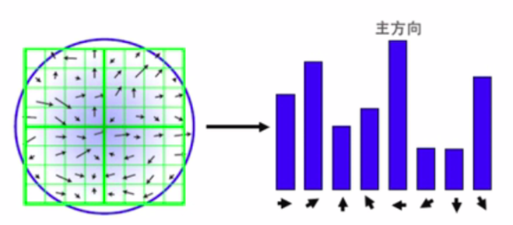
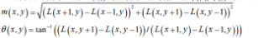
SIFT —— Generating Orientations & Descriptors
Main Orientations
Robustness requirements:
- Secondary direction
- Smoothing
Kaixin CHEN, SSE, 2020
Notes:
在高斯差分图中找到了极值点，之后便是回到尺度空间，以关键点为中心的邻域窗口内采样，并用直方图统计邻域像素的梯度方向。
方向直方图的峰值则代表了该特征点处邻域梯度的方向，以直方图中最大值作为该关键点的主方向。
为了增强匹配的鲁棒性，只保留峰值大于主方向峰值80％的方向（另一个方向的直方图的幅值大于主方向峰值80％的方向）作为该关键点的辅方向。
同时为了防止某个梯度方向角度因受到噪声的干扰而突变，我们还需要对梯度方向直方图进行平滑处理。
==========
Generating Orientations and Descriptors

Slide 11
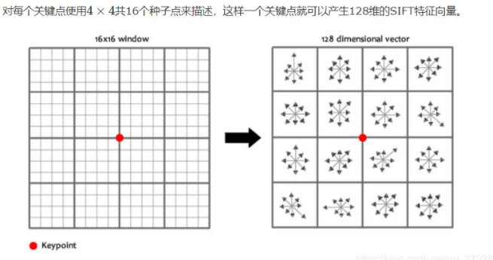
SIFT —— Generating Orientations & Descriptors
Kaixin CHEN, SSE, 2020
Notes:
之后就是熟悉的4*4*8=128个描述子的生成
==========
到此，通过sift算法生成了一幅图像的关键点和描述子。
以上就是关于sift算法的简要分享

Slide 12
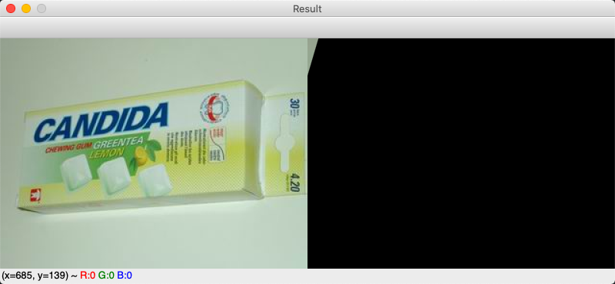
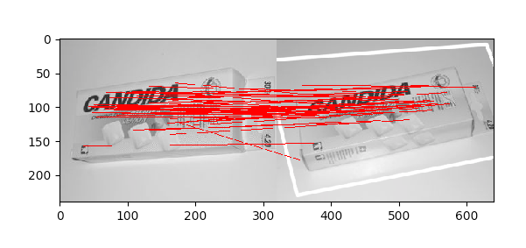
SIFT —— Result
Kaixin CHEN, SSE, 2020
Notes:
这是代码运行的结果。
以上就是关于sift算法的简要分享

Slide 13
Content
SIFT
Scale Space and Image Pyramids
Localizing Extrema
Generating Orientations and Descriptors
SURF
Hessian Detector
Math Behind Hessian Matrix
Construction of feature vector
Comparision between SIFT and SURF
Results
Fast Panorama Stitching on Mobile
Current Approaches
Summary
Color and Luminance Compensation
Optimal Seam Finding and Image Labeling
Image Blending
Results
Yunxin SUN, SSE, 2020
Notes:
下面由我来给大家介绍一下SURF算法。

Slide 14
Overview
The task of finding correspondences can be divided into three stages:
Detection: Find “Interesting points” in two images. => repeatability
Feature Descriptor: =>
Distinctive, robust, simple, rotation and scale invariant
Only scale invariant version: USURF
Match => Not so interesting in SURF
Yunxin SUN, SSE, 2020
Notes:
SURF算法是一套理论框架，用来进行兴趣点检测，构建特征向量，以及对兴趣点进行匹配。 SURF算法的主要贡献在前两点，因此我将着重于讲述兴趣点检测和构建特征向量

Slide 15
Definition 1: Hessian Matrix
Yunxin SUN, SSE, 2020
Notes:
SURF算法使用黑森矩阵 来作为衡量兴趣点的标准
黑森矩阵主要来检测blob结构，一个点的黑森矩阵的定义如图所示，为高斯函数的黑森矩阵与图像的卷积

Slide 16
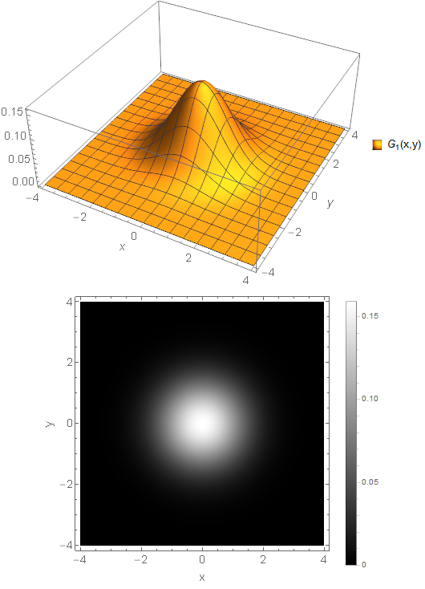
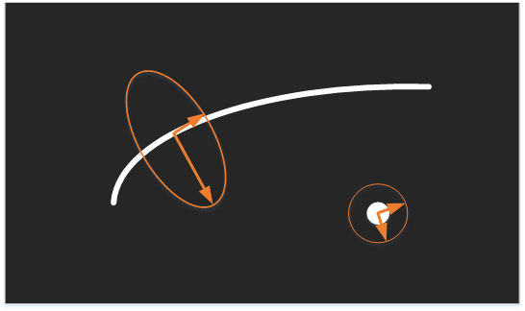
Remarks
Hessian Matrix is used to detect blob like structure.
At a certain point in an image, the two most “interesting” directions are H’s two eigenvectors
The mul of two eigenvalues happen to be the det of H.
We can use the det of H as a indicator to find interesting points.
Only when det of H is greater than zero.
We need to compute
Yunxin SUN, SSE, 2020
Notes:
根据数学的知识可以知道，只有当黑森矩阵的两个特征值的乘积为正且很大时，该点可以构成blob的中心。而黑森矩阵两个特征值的乘积就是黑森矩阵的det，因此我们可以用黑森矩阵的det作为判断点是否为兴趣点的标准。

Slide 17
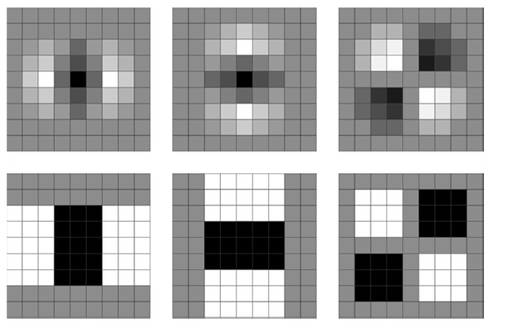
Approx Trick: Box Filter
Yunxin SUN, SSE, 2020
Notes:
在SURF算法中，为了加快计算，他使用了Box filter来替代真正的高斯函数二阶导数
就像在SIFT中使用DoG代替LoG一样。

Slide 18
Definition 2: Integral Image
Yunxin SUN, SSE, 2020
Notes:
另外一个值的注意的点是，SURF算法使用预先计算好的积分图像来计算各种响应值，这相当于用空间换时间，积分图像的定义如下。

Slide 19
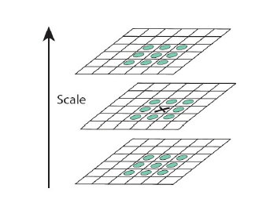
Scale Space
Yunxin SUN, SSE, 2020
Notes:
SURF算法使用Box Filter的不同尺寸来构建尺度空间，当一个点的黑森矩阵det在它邻近的26个点中都是极值时，它就是兴趣点。

Slide 20
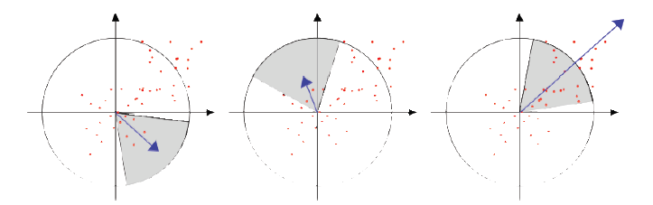
Orientation of each Interesting Point
Yunxin SUN, SSE, 2020
Notes:
下面介绍SURF算法如何构建特征向量，首先对于主方向，SURF算法构造圆心角是pai/3的扇形滑动窗口，求滑动窗口区域内所有点的哈尔小波响应的和，最大值所在扇形的中间轴就是兴趣点的主方向。

Slide 21

Haar Wavelet Response
White stands for average of pixels,
Black stands for difference of pixels.
Yunxin SUN, SSE, 2020
Notes:
大家可以把哈尔小波响应作为一个黑箱函数，每个点的响应是一个向量。

Slide 22
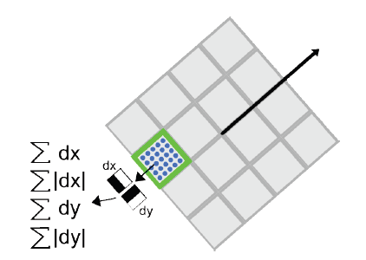
Descriptor Component
Yunxin SUN, SSE, 2020
Notes:
然后SURF算法再构建如图所示的图形，每个小正方形内计算哈尔小波响应的dx, dx绝对值，dy,dy的绝对值之和，每个小正方形有4个数，一共有16个小正方形，

Slide 23
Final Output
N interesting points’ positions(n * 2)
N interesting points’ feature vectors(n * 64)
N interesting points’ characteristic scale(n * 1)
N interesting points’ orientation(n * 1)
Yunxin SUN, SSE, 2020
Notes:
因此一个SURF的兴趣点的特征向量维度是64。

Slide 24
SIFT versus SURF
 | SIFT | SURF
Speed | Slow | Fast
Feature Vector Dimension | 128 | 64
Detector
Approx Tricks | DoG LoG | Box Filter
Construction of Feature Vector | gradient | Haar Wavelet Response
Yunxin SUN, SSE, 2020
Notes:
这张图显示了SIFT和SURF算法的比较，以下是SURF的结果。

Slide 25
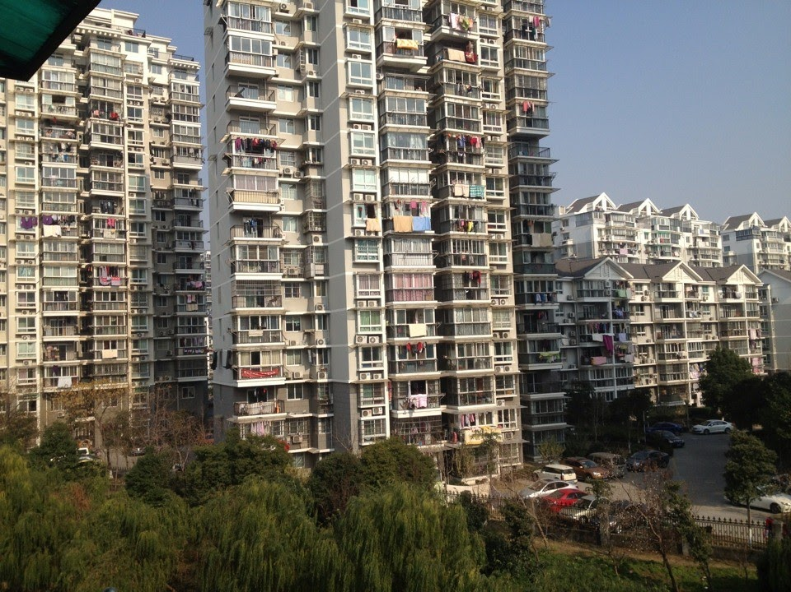
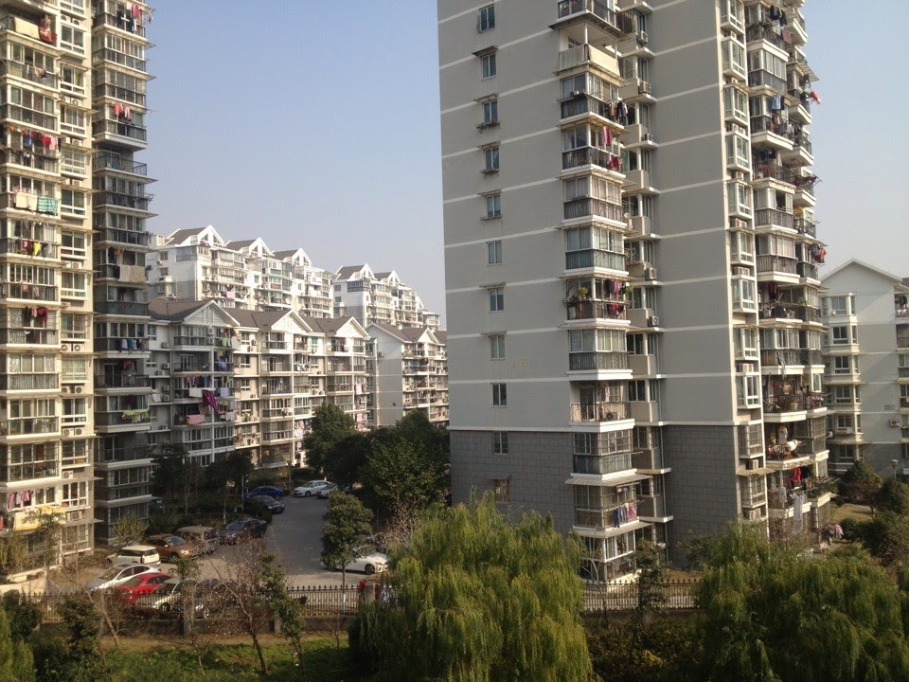
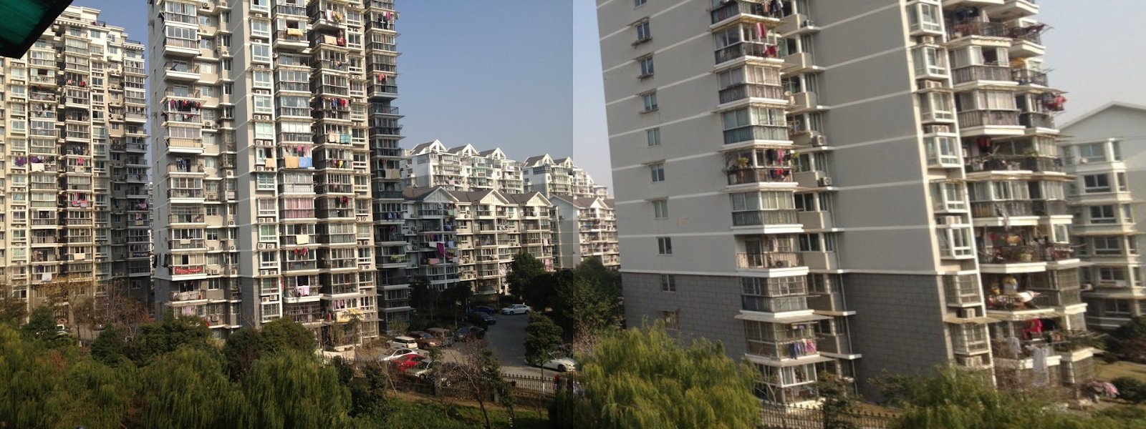
Result
Yunxin SUN, SSE, 2020

Slide 26
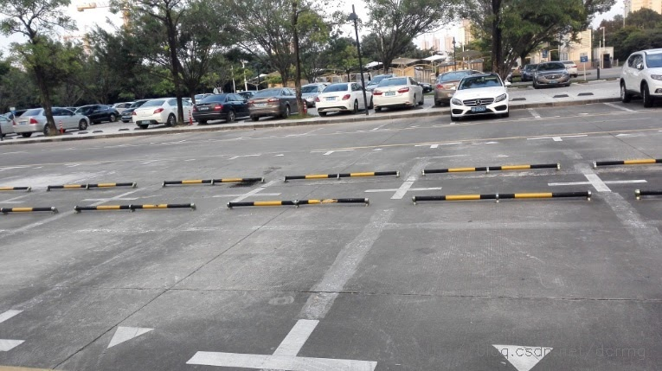
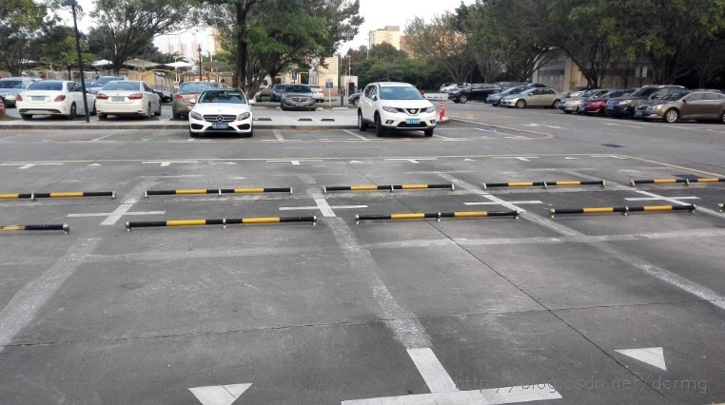
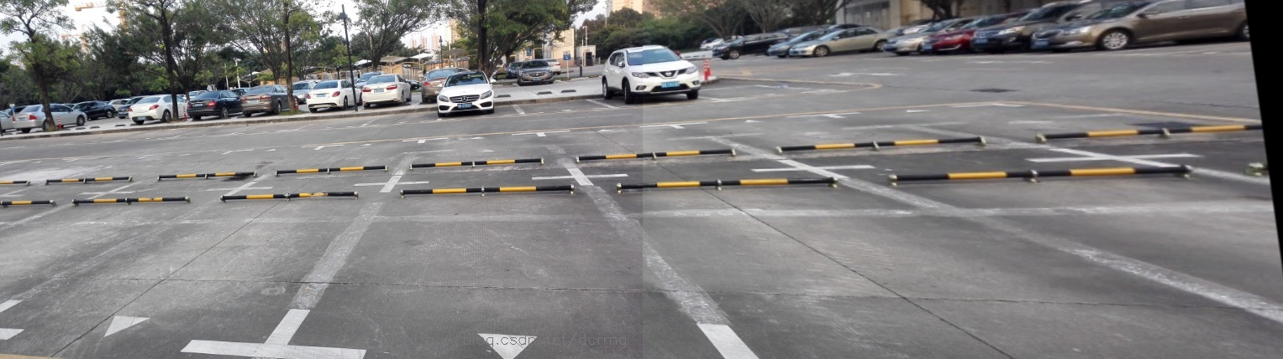
Result
Yunxin SUN, SSE, 2020

Slide 27
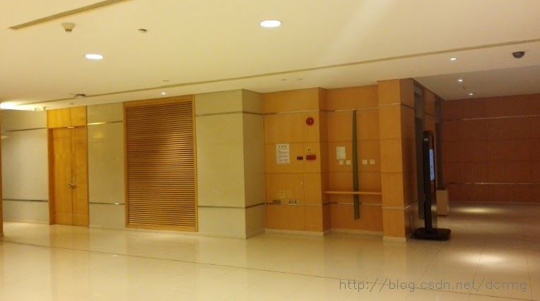
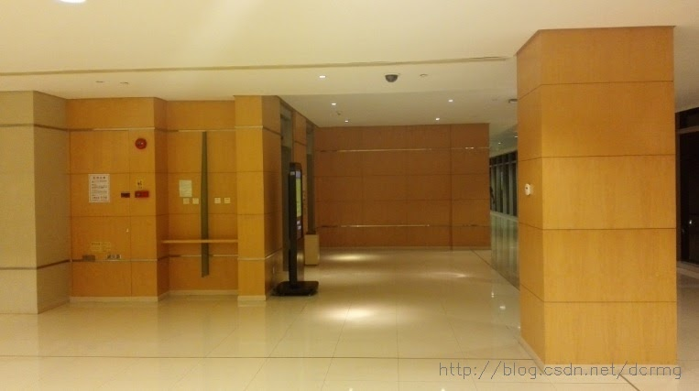
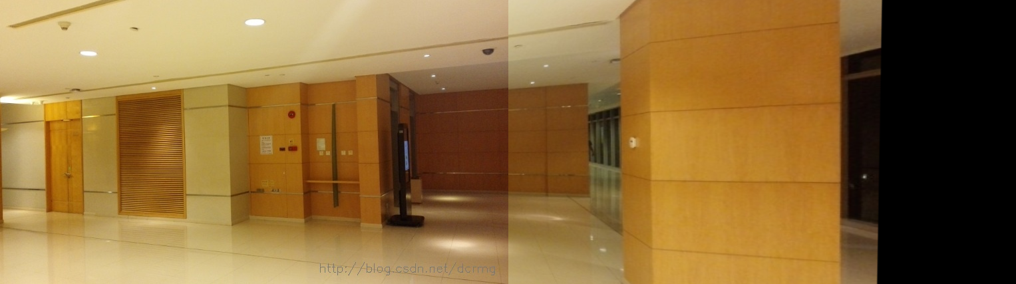
Result
Yunxin SUN, SSE, 2020

Slide 28
SIFT vs SURF
 | SIFT | SURF
Case 1 | 1.78s | 1.57s
Case 2 | 0.64s | 0.32s
Case 3 | 0.21s | 0.14s
Yunxin SUN, SSE, 2020

Slide 29
Content
SIFT
Scale Space and Image Pyramids
Localizing Extrema
Generating Orientations and Descriptors
SURF
Hessian Detector
Math Behind Hessian Matrix
Construction of feature vector
Comparision between SIFT and SURF
Results
Fast Panorama Stitching on Mobile
Current Approaches
Summary
Color and Luminance Compensation
Optimal Seam Finding and Image Labeling
Image Blending
Results
Zhe ZHANG, SSE, 2020
Notes:
第三部分我们研究mobile端的快速全景拼接算法

Slide 30
Current Approaches
transition smoothing: reduce color differences between source images to make seams invisible and remove stitching artifacts
Alpha blending: fast transition smoothing approach, but it cannot avoid ghosting problems caused by object motion and small spatial alignment errors
Gradient Domain Image Blending approaches: can reduce color differences and smooth color transitions using gradient domain operations, producing high-quality composite images
optimal seam finding: search for seams in overlapping areas along paths where differences between source images are minimal
combination: optimal seams first, if seams and stitching artifacts are visible, transition smoothing to reduce color differences to hide the artifacts then
graph cut -> find optimal seams
poisson blending -> smoothing color transitions
Zhe ZHANG, SSE, 2020
Notes:
现在的panorama stitching approaches主要分为两大类，transition smoothing和optimal seam finding以及二者的结合
其中graph cut是现在用的比较多的方法

Slide 31
Current Approaches Problem
computational and memory costs are high
pixels are easy saturated in color correction
don't work well for source images in very different colors and luminance
linear blending, moving objects on the overlapping areas will cause ghosting artifacts
Solution
don't need to keep all source images in memory due to the sequential stitching
dynamic programming for optimal seam finding allowing image labeling much faster than using graph cut
combination of color correction and image blending
high-quality panoramic images from long image sequences with very different colors and luminance
work well on both indoor and outdoor scenes
Zhe ZHANG, SSE, 2020
Notes:
但是这些算法存在一些问题，比如图像颜色和光照的差别很大的图像效果非常差
Mobile也存在些自己的约束，比如memory少等等问题

Slide 32
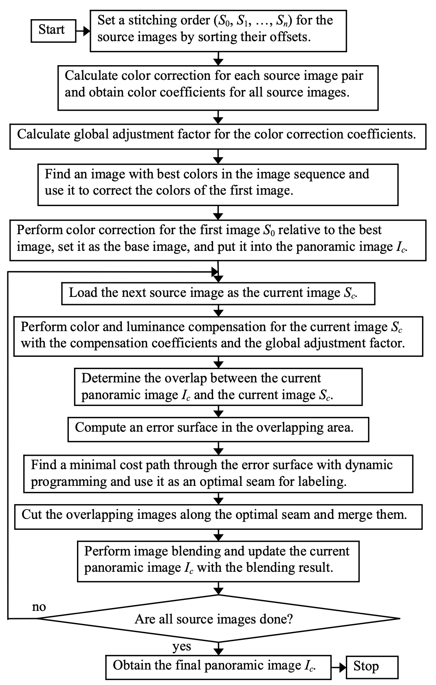
Summary
Fast Panorama Stitching for High-Quality Panoramic Images on Mobile Phones Yingen Xiong and Kari Pulli, Member, IEEE
Color Correction
color correction for all source images to reduce color differences
smoothen remaining color transitions between adjacent images
Image Labeling
error surface is constructed with squared differences between overlapping images
low-cost path is found through the error surface by dynamic programming and used as an optimal seam to create labeling
Image Blending Operations
linear blending -> source images are similar in color and luminance
poisson blending -> colors remain too different
Zhe ZHANG, SSE, 2020
Notes:
我们的算法来自这篇论文，主要分为三大个模块
首先进行color correction

Slide 33
Summary
Color Correction
color correction for all source images to reduce color differences
smoothen remaining color transitions between adjacent images
Image Labeling
error surface is constructed with squared differences between overlapping images
low-cost path is found through the error surface by dynamic programming and used as an optimal seam to create labeling
Image Blending Operations
linear blending -> source images are similar in color and luminance
poisson blending -> colors remain too different
Zhe ZHANG, SSE, 2020
Notes:
之后进行最优接缝的寻找和image labeling

Slide 34
Summary
Color Correction
color correction for all source images to reduce color differences
smoothen remaining color transitions between adjacent images
Image Labeling
error surface is constructed with squared differences between overlapping images
low-cost path is found through the error surface by dynamic programming and used as an optimal seam to create labeling
Image Blending Operations
linear blending -> source images are similar in color and luminance
poisson blending -> colors remain too different
Zhe ZHANG, SSE, 2020
Notes:
第三步进行图像融合

Slide 35
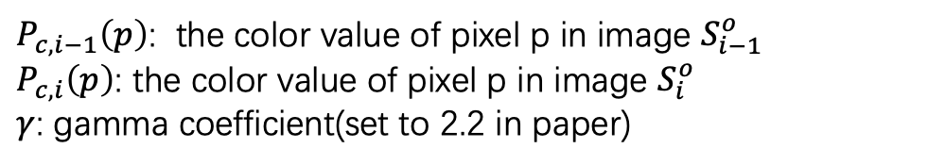
Color and Luminance Compensation
Basic idea: compute light averages in the overlap area by linearizing the gamma-corrected RGB
Suppose $S_{i−1}$ and $S_{i}$ are adjacent images, $S_{i−1}^{o}$ and $S_{i}^{o}$ are where image overlap
$P_{c,i−1}\left(p\right)$: the color value of pixel p in image $S_{i−1}^{o}$
$P_{c,i}\left(p\right)$: the color value of pixel p in image $S_{i}^{o}$
$γ$: gamma coefficient(set to 2.2 in paper)
Zhe ZHANG, SSE, 2020
Notes:
颜色和光照校正的核心思想其实还是 gamma校正
主要分为两个步骤
第一步是aci也就是相邻两个图像重叠区域的一个校正因子

Slide 36
Color and Luminance Compensation
Basic idea: compute light averages in the overlap area by linearizing the gamma-corrected RGB
$g_{c}$: global adjustment in the whole image sequence for each color channel $c$
Solve the least-squares equation
Zhe ZHANG, SSE, 2020
Notes:
第二个是最优一个方程组得到的全局调整因子，这里我们用导数=0的闭式解来做

Slide 37
Color and Luminance Compensation
Basic idea: compute light averages in the overlap area by linearizing the gamma-corrected RGB
Zhe ZHANG, SSE, 2020
Notes:
最终我们综合这两个调整因子
对原像素做一个gamma校正

Slide 38
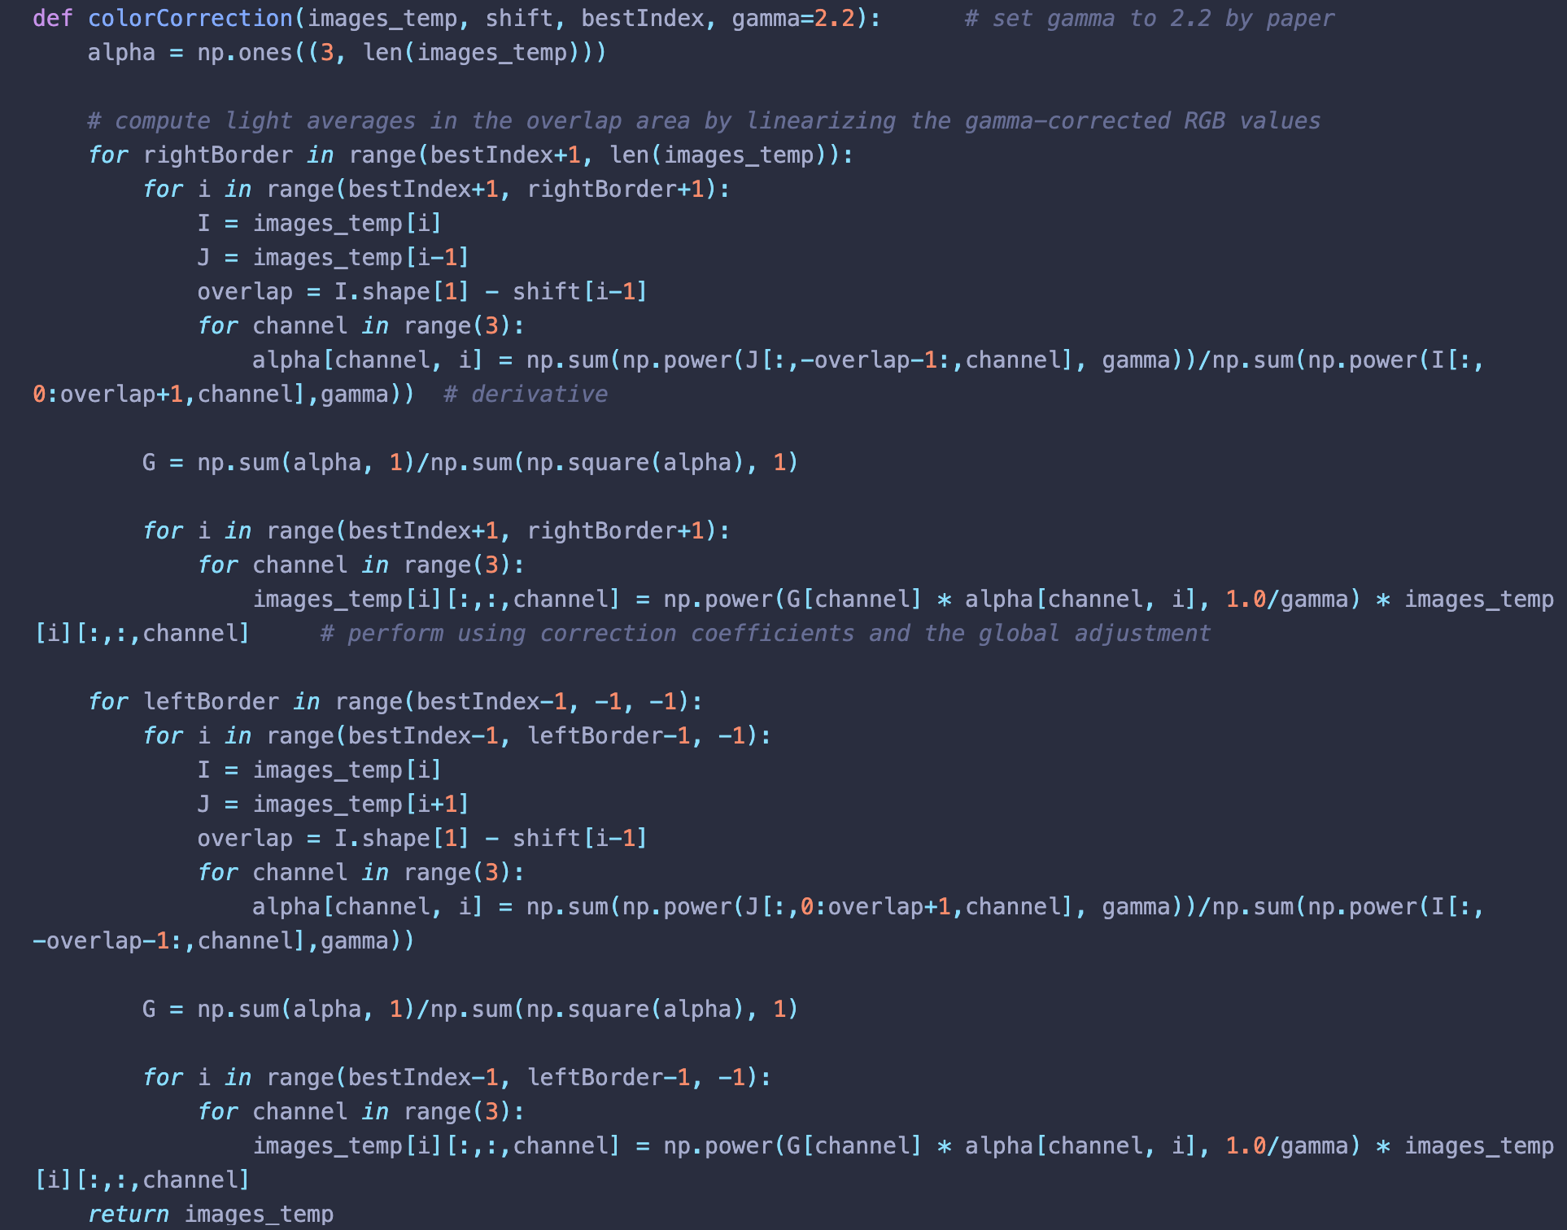
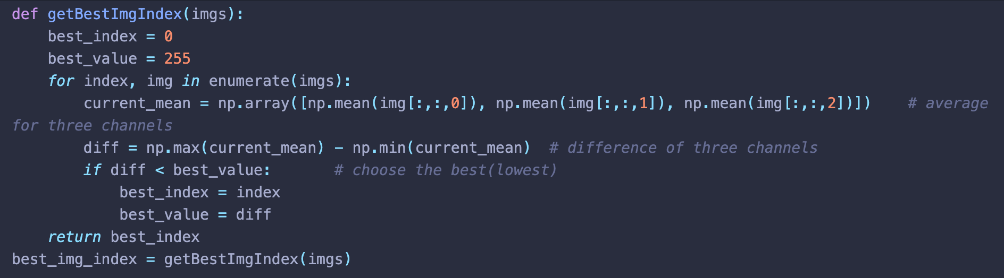
Color and Luminance Compensation
Zhe ZHANG, SSE, 2020
Notes:
这是我们的实现
首先要找到一张最优图片，这个其实偏重主观审美
我们采用的是寻找三个通道的均值极差越小越好（这个主要用在white balancing上）

Slide 39
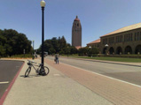
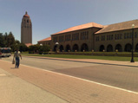
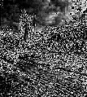
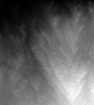
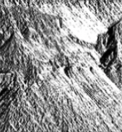
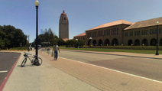
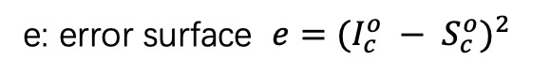
Optimal Seam Finding and Image Labeling
Input images
e: error surface $e={(I_{c}^{o} − S_{c}^{o})}^{2}$
E: cumulative minimum squared difference
All possible paths
Optimal path $m_{c}$: tracking back the paths with a minimal cost from bottom to top
Panorama image
Zhe ZHANG, SSE, 2020
Notes:
第二部分我们最核心的是三个步骤
首先在颜色校正的基础上计算error surface
然后通过dynamic programming的方法一行行扫描error surface，计算一个累积的最小平方差
第三部就是通过回溯在所有可能的path中找到最优的一条接缝

Slide 40
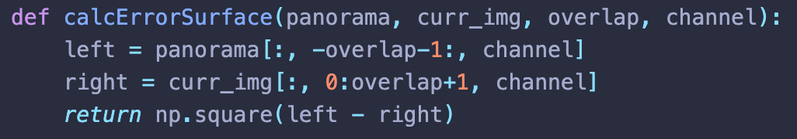
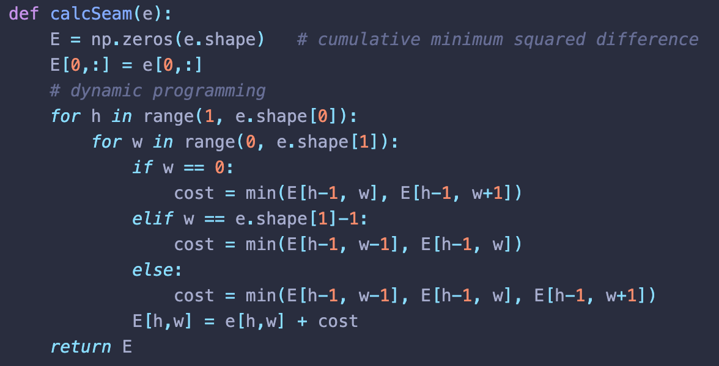
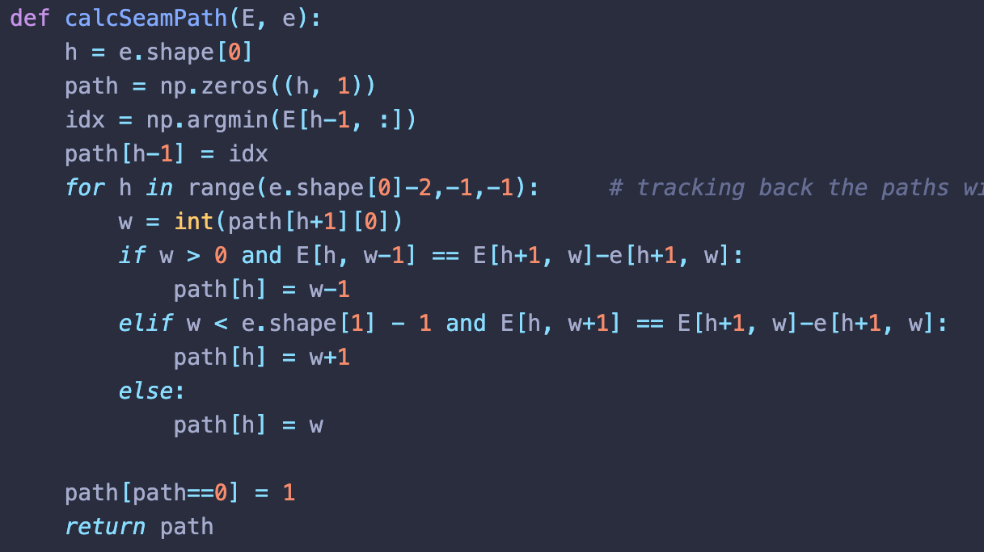
Optimal Seam Finding and Image Labeling
Input images
Panorama image
Zhe ZHANG, SSE, 2020
Notes:
这是我们每个模块的实现

Slide 41
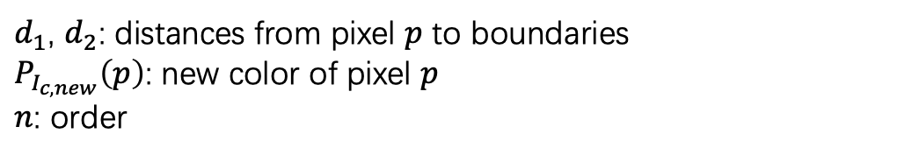
Image Blending
Simple linear blending: images are similar in color and luminance after color correction
$δ$ pixels width on both sides of the seam
$d_{1}$, $d_{2}$: distances from pixel $p$ to boundaries
$P_{I_{c,new}}\left(p\right)$: new color of pixel $p$
$n$: order
Zhe ZHANG, SSE, 2020
Notes:
最后一部分就是在接缝找到的基础上进行拼接，也就是图像融合
我们是找到两大个方法
简单线性融合，这个比较简单我们就略过了

Slide 42
Image Blending
Poisson blending: perform image blending in the gradient domain
$(G_{x},G_{y})$: gradients of source images using the labeling obtained using optimal seams
solve linear practical differential equation by fixing the colors at the seam and solving new colors $I(x,y)$ ​ over the gradient field
Zhe ZHANG, SSE, 2020
Notes:
第二种是泊松融合，其实使用的是梯度的信息
第三行公式是我们的一个离散展开

Slide 43
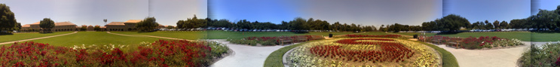
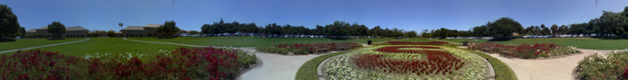
Results
Zhe ZHANG, SSE, 2020
Notes:
最后是我们的实现效果
这组图像的颜色差异很大，上面的是没有做颜色校正的

Slide 44
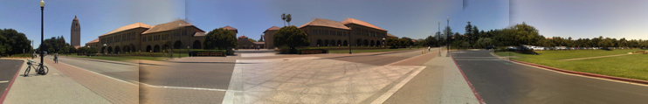


Results
Zhe ZHANG, SSE, 2020
Notes:
这组图第一个是没做颜色校正的
第二个是没做融合的，可以看到明显的锯齿接缝

Slide 45
Computer Vision
Thanks For Listening
Zhe ZHANG, 1754060
Kaixin CHEN, 1753188
Yunxin SUN, 1551534
School of Software Engineering
Tongji University
Spring 2020
Group, SSE, 2020

